Slide 1
Support vector machine
What it is?
Linearly separable and inseparable data
Python implementation
Use cases
Kumar Sundram

Slide 2
What is SVM
one of the most popular and talked about machine learning algorithms
go-to method for a high-performing algorithm with little tuning
developed in the 1990s
A sophisticated idea but has a simple implementation

Slide 3
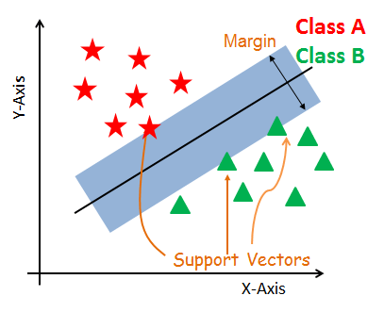
What it is
A supervised machine learning algorithm that can be used for both classification and regression and outlier detection
Considered to be a classification approach, generally.
SVMs are based on the idea of finding a hyperplane.
SVM constructs a hyperplane in multidimensional space to separate different classes
SVM generates optimal hyperplane in an iterative manner
Find a maximum marginal hyperplane(MMH) that best divides the dataset into classes – widest street approach
Handles both the continuous and categorical variables.

Slide 4
Support Vectors
Support vectors are the data points nearest to the hyperplane,
These points will define the separating line better by calculating margins.
Because of this, they can be considered the critical elements of a data set.

Slide 5
hyperplane
A line that linearly separates and classifies a set of data.
Intuitively, the further from the hyperplane our data points lie, the more confident we are that they have been correctly classified.
So when new testing data is added, whatever side of the hyperplane it lands will decide the class that we assign to it.

Slide 6
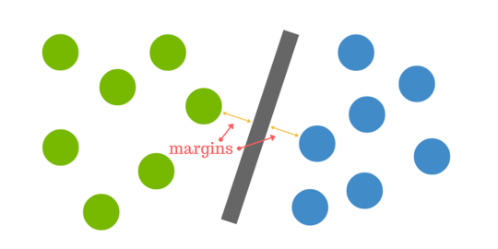
margin
The distance between the hyperplane and the nearest data point from either set is known as the margin.
The goal is to choose a hyperplane with the greatest possible margin between the hyperplane and support vector (widest street approach)
simple SVM algorithm can be used to find decision boundary for linearly separable data.
widest street approach

Slide 7
How does SVM work?
The main objective is to segregate the given dataset in the best possible way.
The distance between the either nearest points (support vectors ) is known as the margin.
The objective is to select a hyperplane with the maximum possible margin between support vectors in the given dataset. SVM searches for the maximum marginal hyperplane

Slide 8
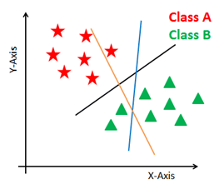
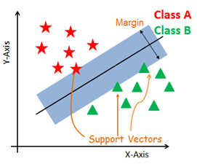
How does SVM work?
3 hyperplanes black, blue and orange
the blue and orange have higher classification error, but the black is separating the two classes correctly.
Select the right hyperplane with the maximum segregation from the either nearest data points

Slide 9
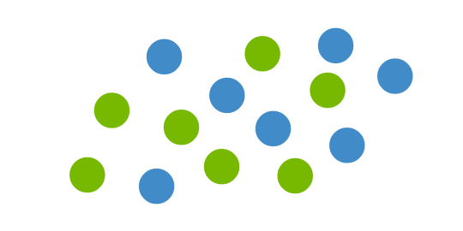
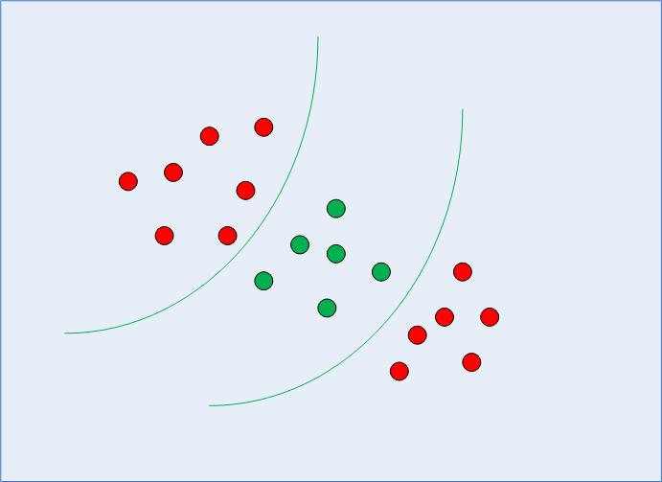
But what happens when there is no clear hyperplane?
Some problems can’t be solved using linear hyperplane
Data is rarely ever as clean
A dataset will often look more like the jumbled balls which represent a linearly non separable dataset.
straight line cannot be used as a decision boundary.
modified version of SVM, called Kernel SVM, is used

Slide 10
Non-linearly Separable Data
Basically, the kernel SVM projects the non-linearly separable data lower dimensions to linearly separable data in higher dimensions
data points belonging to different classes are allocated to different dimensions.
there is complex mathematics involved in this,
simply use Python's Scikit-Learn library to implement and use the kernel SVM.

Slide 11
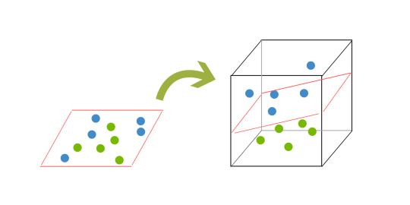
2d to 3d
In order to classify a dataset like the previous case it’s necessary to move away from a 2d view of the data to a 3d view.
Imagine that our 2 sets of colored balls above are sitting on a sheet and this sheet is lifted suddenly, launching the balls into the air.
While the balls are up in the air, you use the sheet to separate them.
This ‘lifting’ of the balls represents the mapping of data into a higher dimension. This is known as kernelling.

Slide 12
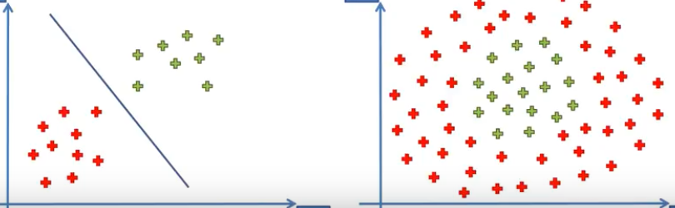
separability
Linear
Non-linear
Add an extra dimension
Move points to higher dimension

Slide 13
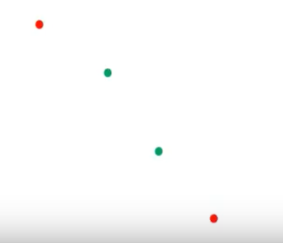
Example
How do we separate the points?

Slide 14
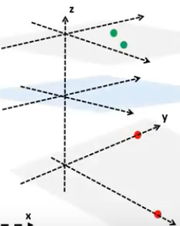
Example
If we can lift the green points up in 3D, then we can have a hyperplane – separate the points from the red ones

Slide 15
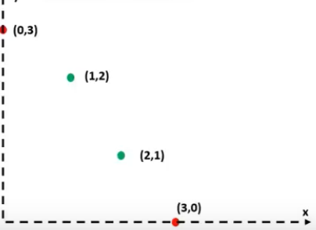
example
What type of equation can be useful to lift the points?
X + Y
X * Y
X²
We need a function which can give smaller values for the red points and higher values to the green points or vice versa.
 | (0,3) | (1,2) | (2,1) | (3,0)
X + Y | 3 | 3 | 3 | 3
X * Y | 0 | 2 | 2 | 0
X² | 0 | 1 | 4 | 9

Slide 16
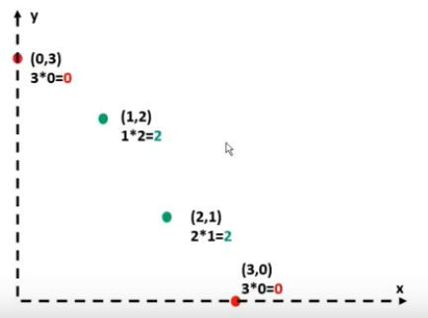
example
X * Y = 0 X * Y = 1 X * Y = 2
Y = 1/X
Hyperbola!!!

Slide 17
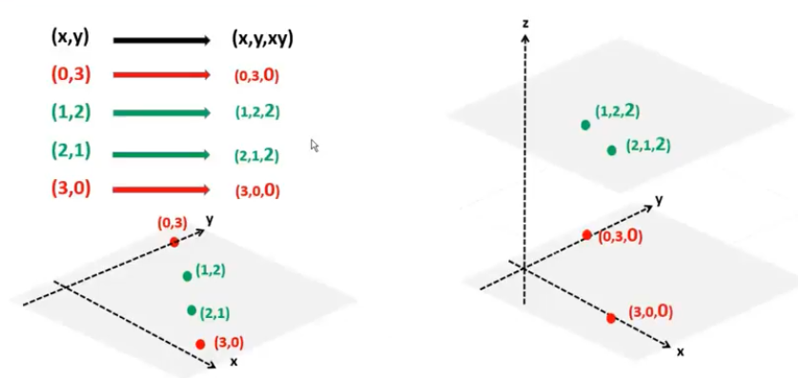
example
Kernel trick !!!!

Slide 18
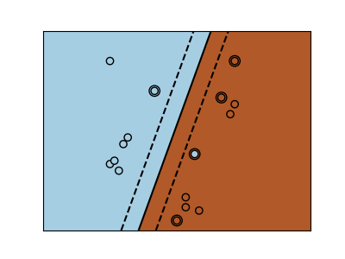
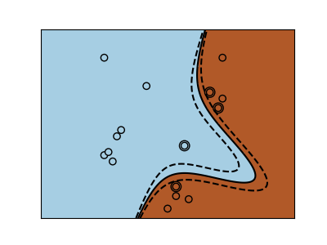
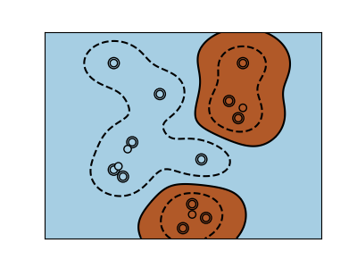
Types of svm
SVC, NuSVC and LinearSVC are classes capable of performing multi-class classification on a dataset.
linear kernel
RBF kernel SVM

Slide 19



Kernel types
Polynomial kernel | popular in image processing.
Gaussian kernel | It is a general-purpose kernel; used when there is no prior knowledge about the data
Gaussian radial basis function (RBF) | It is a general-purpose kernel; used when there is no prior knowledge about the data.
Laplace RBF kernel | It is general-purpose kernel; used when there is no prior knowledge about the data.
Hyperbolic tangent kernel | We can use it in neural networks.

Slide 20
Pros & Cons of Support Vector Machines
Pros
Accuracy
Works well on smaller cleaner datasets
It can be more efficient because it uses a subset of training points
Cons
Isn’t suited to larger datasets as the training time with SVMs can be high
Less effective on noisier datasets with overlapping classes

Slide 21
Multi-class Classification
SVM by definition is well suited for binary classification. In order to perform multi-class classification, the problem needs to be transformed into a set of binary classification problems.
One vs. Rest Approach (OvR): This strategy involves training a single classifier per class, with the samples of that class as positive samples and all other samples as negatives. This strategy requires the base classifiers to produce a real-valued confidence score for its decision, rather than just a class label; discrete class labels alone can lead to ambiguities, where multiple classes are predicted for a single sample.
One vs. One Approach (OvO): In the one-vs.-one (OvO) strategy, one trains K(K − 1)/2 binary classifiers for a K-way multi-class problem; each receives the samples of a pair of classes from the original training set, and must learn to distinguish these two classes. At prediction time, a voting scheme is applied: all K(K − 1)/2 classifiers are applied to an unseen sample and the class that got the highest number of “+1” predictions gets predicted by the combined classifier. Like OvR, OvO suffers from ambiguities in that some regions of its input space may receive the same number of votes.
In svm.svc implementation, decision_function_shape parameter provides the option to choose one of two strategy. Although, by default OvO strategy is chosen for historical reasons, it is always recommended to switch to the OvR approach.

Slide 22
SVM Uses
SVM is used for text classification tasks such as category assignment, detecting spam and sentiment analysis.
It is also commonly used for image recognition challenges, performing particularly well in aspect-based recognition and color-based classification.
SVM also plays a vital role in many areas of handwritten digit recognition, such as postal automation services.

Slide 23
Logit - decision trees - SVM
 | Logit | Decision Trees | SVM
Pros | probability scores for observations Multi-collinearity is not really an issue and can be countered with L2 regularization to an extent Wide spread industry comfort for logistic regression solutions | Intuitive Decision Rules Can handle non-linear features Take into account variable interactions | Can handle large feature space Can handle non-linear feature interactions Do not rely on entire data
Cons | Doesn’t perform well when feature space is too large Doesn’t handle large number of categorical features/variables well Relies on transformations for non-linear features Relies on entire data | Highly biased to training set [Random Forests to the rescue] No ranking score as direct result | Not very efficient with large number of observations It can be tricky to find appropriate kernel sometimes

Slide 24
Logit - decision trees - SVM
Always start with logistic regression, if nothing then to use the performance as baseline
See if decision trees (Random Forests) provide significant improvement.
Even if you do not end up using the resultant model, you can use random forest results to remove noisy variables
Go for SVM if you have large number of features and number of observations are not a limitation for available resources and time
Good data beats any algorithm anytime. Always see if you can engineer a good feature by using domain knowledge.
Try various iterations of your ideas while experimenting with feature creation.
Use ensembles of multiple models.

Slide 25
sklearn.svm.SVC
sklearn.svm.SVC(C=1.0, kernel=’rbf’, degree=3, gamma=’auto_deprecated’, coef0=0.0, shrinking=True, probability=False, tol=0.001, cache_size=200, class_weight=None, verbose=False, max_iter=-1, decision_function_shape=’ovr’, random_state=None)
C : float, optional (default=1.0)
Penalty parameter C of the error term.
kernel : string, optional (default=’rbf’)
‘linear’,
‘poly’,
‘rbf’,
‘sigmoid’,
‘precomputed’
or a callable.

Slide 26
sklearn.svm.SVC
sklearn.svm.SVC(C=1.0, kernel=’rbf’, degree=3, gamma=’auto_deprecated’, coef0=0.0, shrinking=True, probability=False, tol=0.001, cache_size=200, class_weight=None, verbose=False, max_iter=-1, decision_function_shape=’ovr’, random_state=None)
degree : int, optional (default=3) - Degree of the polynomial kernel function (‘poly’).
gamma : float, optional (default=’auto’)
Kernel coefficient for ‘rbf’, ‘poly’ and ‘sigmoid’.
Current default is ‘auto’ which uses 1 / n_features, if gamma='scale' is passed then it uses 1 / (n_features * X.std()) as value of gamma.

Slide 27
attributes
support_ : array-like, shape = [n_SV] - Indices of support vectors.
support_vectors_ : array-like, shape = [n_SV, n_features] - Support vectors.
n_support_ : array-like, dtype=int32, shape = [n_class] - Number of support vectors for each class.
dual_coef_ : array, shape = [n_class-1, n_SV]
Coefficients of the support vector in the decision function. For multiclass, coefficient for all 1-vs-1 classifiers. The layout of the coefficients in the multiclass case is somewhat non-trivial. See the section about multi-class classification in the SVM section of the User Guide for details.
coef_ : array, shape = [n_class * (n_class-1) / 2, n_features] - Weights assigned to the features (coefficients in the primal problem). This is only available in the case of a linear kernel.
intercept_ : array, shape = [n_class * (n_class-1) / 2] Constants in decision function.

Slide 28
The Nature of Statistical Learning Theory, Vapnik, 1995
Statistical Learning Theory, Vapnik, 1998

